Slide 1
Species as datapoints Comparative Methods Biology 683 Heath Blackmon
Joe Felsenstein

Slide 2
The Problem
Does body size impact brain size?
Does flight effect speciation rate?
Does the evolution of some traits make species more likely to go extinct?
Do structures in predators and prey coevolve?
Are the expression level of some genes maintained over evolutionary time scales?
How many times have eyes evolved?
Some questions are hard to ask with experimental studies!

Slide 3
The Problem
An example from R

Slide 4
Solutions
Calculating independent contrasts
Only good for two continuous traits
Treating a phylogeny as a covariance matrix
PGLS
Creating a process based model that explicitly incorporates the phylogeny into the likelihood calculation
BAMM
Diversitree
Simulation using a monte carlo approach

Slide 5
Independent Contrasts
library(ape)
pic(tree, x)

Slide 6
Assumptions
If our trait does not fit a Brownian motion model then we may have biased results.
If our branch lengths are inaccurate we will have error.
If we misplace taxa we will have error and reduced power.

Slide 7
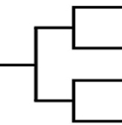
Phylogeny as a covariance matrix
 | A | B | C | D
A | 1 | 0.66 | 0.33 | 0.33
B |  | 1 | 0.33 | 0.33
C |  |  | 1 | 0.66
D |  |  |  | 1
Species A
Species B
Species C
Species D
0 1 2 3
Mathematically it can be shown that phylogenetic independent contrasts are a special case of this approach

Slide 8
Phylogeny as a covariance matrix
library(ape)
Library(nlme)
pglsModel <- gls(y ~ x,
correlation = corBrownian(phy),
data = data)
This is a less restricted approach because it allows us to fit different correlation structures. Still can be difficult/impossible to deal with discrete variables.

Slide 9
Process based model
Process based models can be developed where we calculate the likelihood of our data given a model and the tip states. These models can include things like speciation, extinction, sampling bias, discrete and continuous characters.

Slide 10
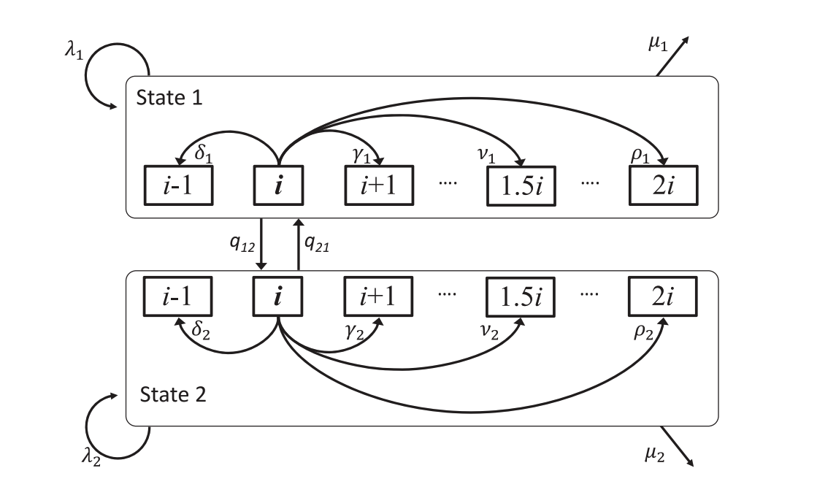
Example with chromosomes
10
11
22
23

Slide 11
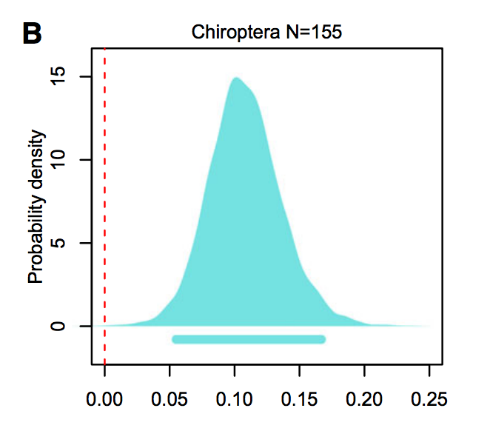
Example with chromosomes
With process based models we are usually interested in the parameters of the model and do model comparison to find the best model or Bayesian analyses where we compare parameters in the model

Slide 12
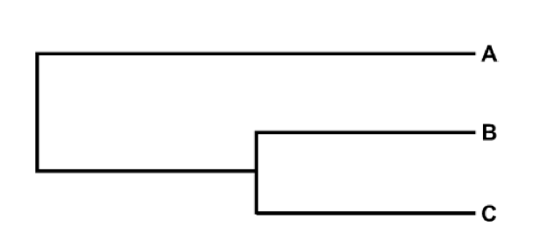
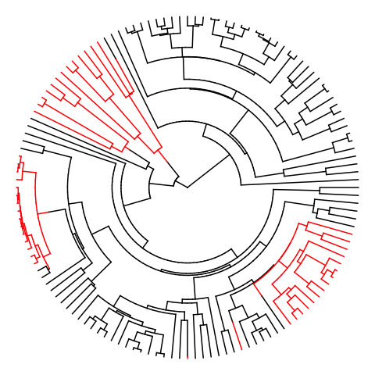
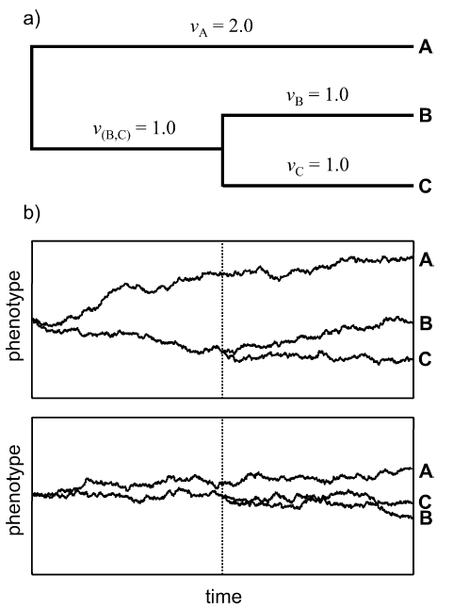
Example from beetles
Single parameter:
σ² the “drift” parameter
vs.
σ²
σ² & σ²
From Revell 2008

Slide 13
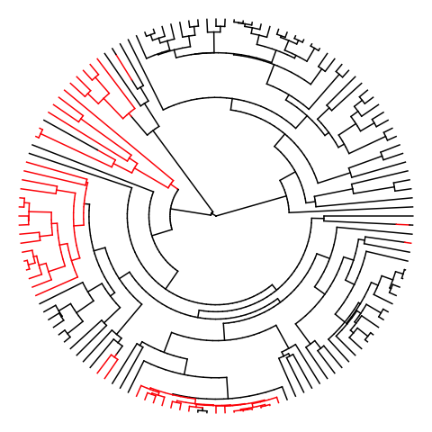
Effect of wing loss on rate of chromosome evolution
Example from beetles
2 rate model preferred on all
500 trees max p-val < 0.01
Winged
Wingless
Winged σ² = 1.5 Wingless σ² = 9.1

Slide 14
Estimation via Monte Carlo
Using regular stats test then simulating a lot of data and getting a null distribution of stats (like the f-statistic if you are doing anova). These are implemented for most things you might want.
APE, Geiger, and Phytools
Simulating data and getting a null distribution for any value you are interested in.

Slide 15
Estimation via Monte Carlo
Using existing stats:
library(geiger)
fit <- aov.phylo(y~x, phy, nsim=100)
Creating your own tests and Monte Carlos isn’t hard

Slide 16
An example from Hymenoptera
Hypothesis: Eusociality should lead to selection for higher recombination and by extension higher chromosome number.
Sherman 1979

Slide 17
An example from Hymenoptera
On average one crossover per arm per meiosis:
1
1
1
1
1
1
1
1
1
1
1
1
1
2
2
2
2
2
2
2
2
2
2
2
2
2
With 1 chromosome:
3
3
3
3
3
3
3
3
3
3
3
3
3
4
4
4
4
4
4
4
4
4
4
4
4
4
5
5
5
5
5
5
5
5
5
5
5
5
5
6
6
6
6
6
6
6
6
6
6
6
6
6
♀
♂
5 Genotypes
8 Genotypes
♀
♂
1
1
1
1
1
1
1
1
1
1
1
1
1
1
1
1
1
1
1
2
2
2
2
2
2
2
2
2
2
2
2
2
2
2
2
2
2
2
3
3
3
3
3
3
3
3
3
3
3
3
3
3
3
3
3
3
3
With 3 chromosomes:
4
4
4
4
4
4
4
4
4
4
4
4
4
4
4
4
4
4
4
5
5
5
5
5
5
5
5
5
5
5
5
5
5
5
5
5
5
5
6
6
6
6
6
6
6
6
6
6
6
6
6
6
6
6
6
6
6

Slide 18

An example from Hymenoptera
Standard ANOVA
p-value < 0.001
Phylo - ANOVA
F-statistic = 70.5,
p-value = 0.23
■ Eusocial
■ Solitary
1 60
Chromosomes

Slide 19
Origins of haplodiploidy
Bull’s hypothesis
Species with relatively few chromosomes should experience transitions to haplodiploidy more frequently than species with many chromosomes.
Bull 1979, 1983

Slide 20
Origins of haplodiploidy
2 XY
16% of genome
1
2
X
1
2
X Y
1
2
X
♀
♂
♂
Fusion between chromosome 2 and X; followed by degeneration of neoY
1 XY
50% of genome
1
1
1
X
X Y
X
♀
♂
♂

Slide 21
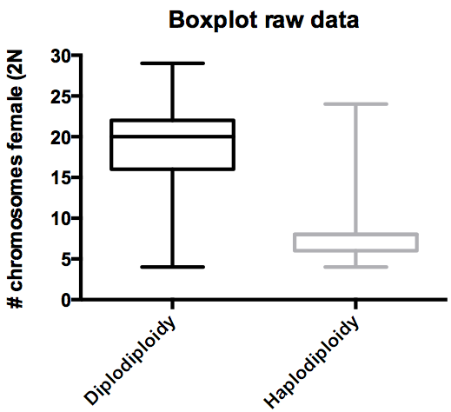
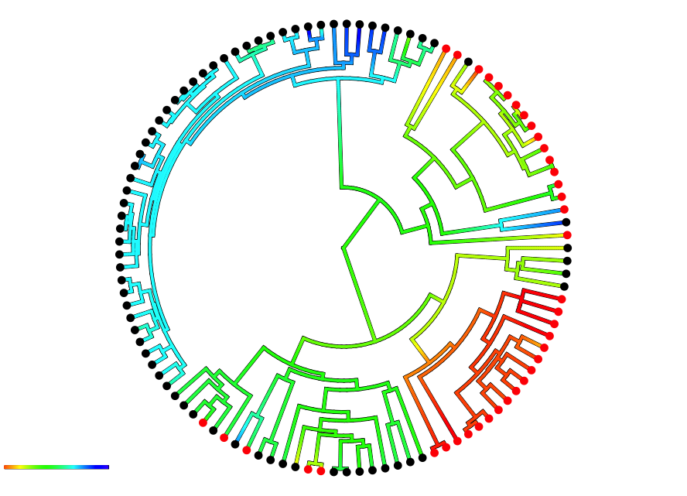
Origins of haplodiploidy
■ Diplodiploid
■ Haplodiploid
4 29
Phylo - ANOVA
F-statistic = 97.8,
p-value < 0.001

Slide 22
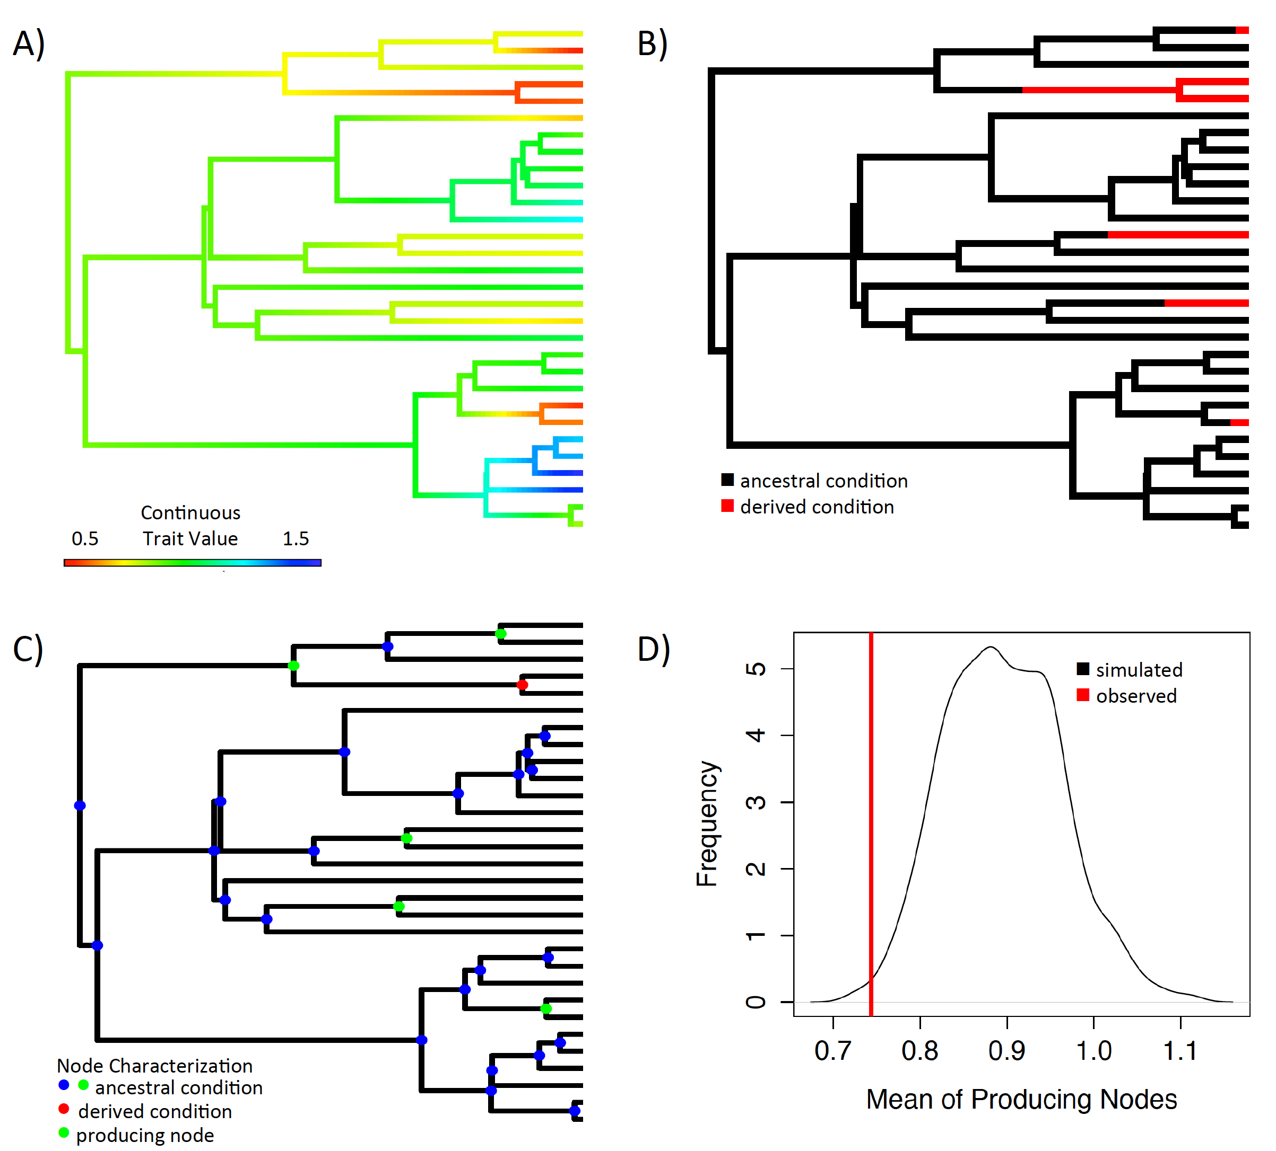
Ancestral condition test
1
15

Slide 23
Ancestral condition test
Diplodiploid
Haplodiploid

Slide 24
Ancestral condition test
7 8 9 10 11

Slide 25
Section 4: Origins of haplodiploidy
Origins of
Haplodiploidy
P-value = 0.019
Null

Slide 26
Resources
R CRAN phylogenetics task view
Inferring phylogenies
Bodega Bay Phylogenetics Workshop
Me if you’ve already googled a little

Slide 27
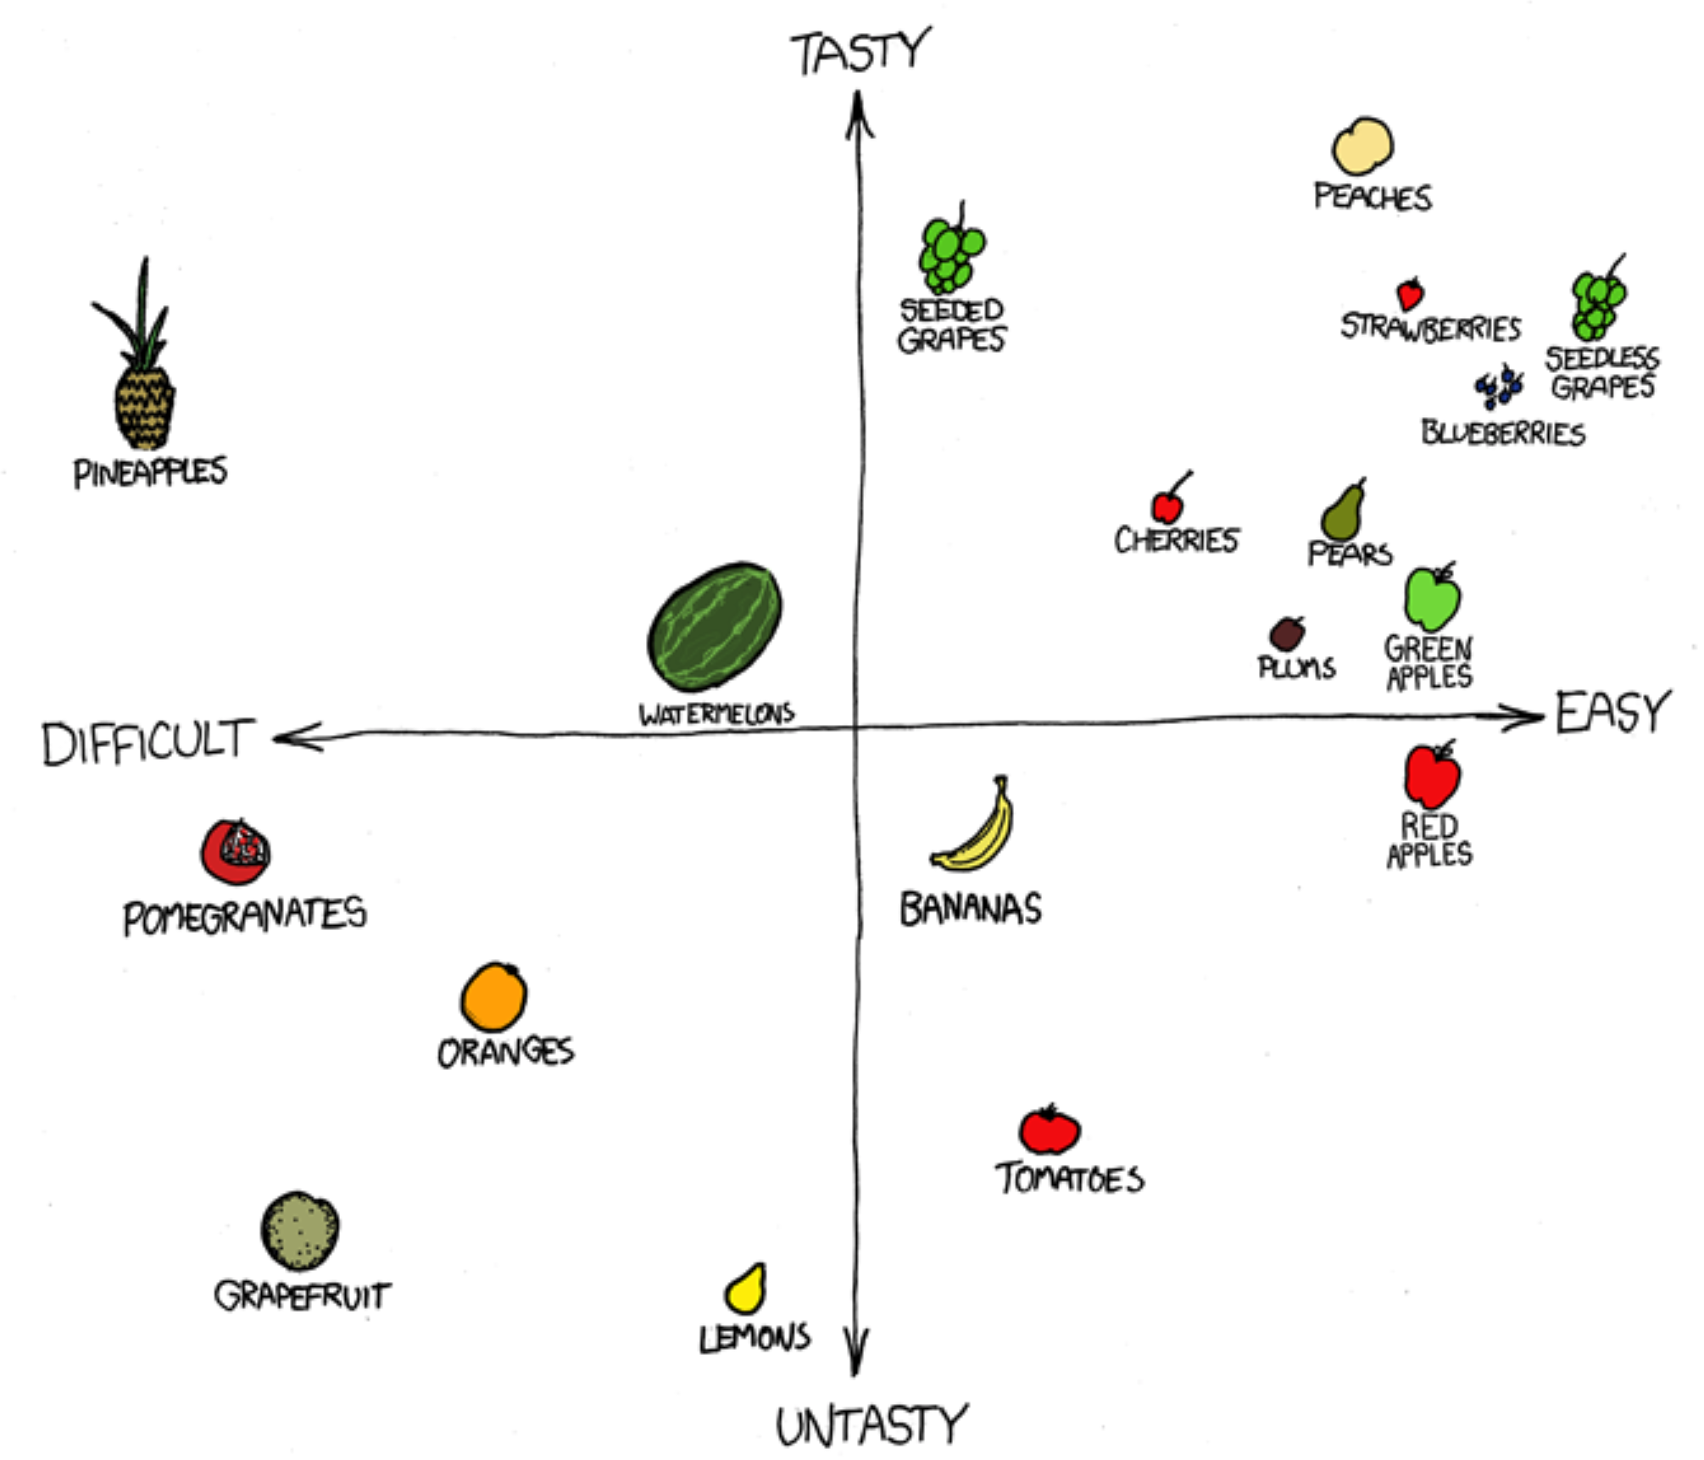
For Thursday
Bring laptop to class!
Heath Blackmon
BSBW 309
coleoguy@gmail.com
@coleoguy

